Slide 1
PHISHING DETECTION & AWARENESS REPORT
Future Interns — Cyber Security Internship
Prepared By:
Sidhanth Achar
Tools Used:
Email Header Analyzer
Browser Tools
Public Phishing Samples

Slide 2
INTRODUCTION
Phishing is one of the most common cyber attacks targeting businesses and individuals.
Attackers use fake emails, malicious links, and social engineering techniques to steal credentials, passwords, and sensitive information.
This project focuses on identifying phishing indicators and improving user awareness through ethical email analysis.
OBJECTIVE
• Analyze phishing email samples
• Identify phishing indicators
• Classify email risks
• Explain phishing techniques
• Provide prevention recommendations
• Build user awareness

Slide 3
TOOLS USED
• Email Header Analyzer
• Browser Inspection Tools
• Public Phishing Email Samples
• Google Docs / Canva
Purpose:
To analyze suspicious emails and identify phishing indicators safely and ethically.

Slide 4
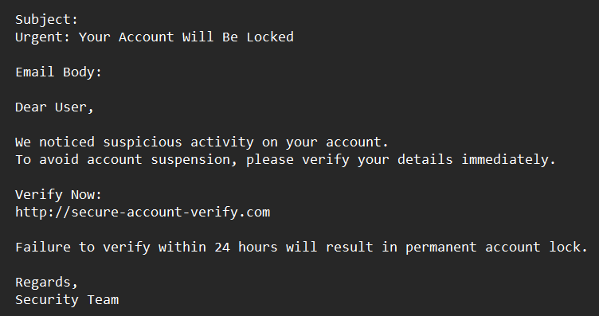
SAMPLE EMAIL 1
Subject:
⚠️ Urgent: Your Account Will Be Locked
Key Indicators:
• Suspicious link
• Generic greeting
• Urgent language
• Fear-based messaging
Risk Classification:
PHISHING EMAIL

Slide 5
ANALYSIS OF SAMPLE 1
Identified Indicators:
• Suspicious verification domain
• Urgency tactics
• Social engineering
• Potential credential theft risk
Business Impact:
Users may unknowingly share passwords or sensitive information through fake login pages.
Overall Risk:
HIGH

Slide 6
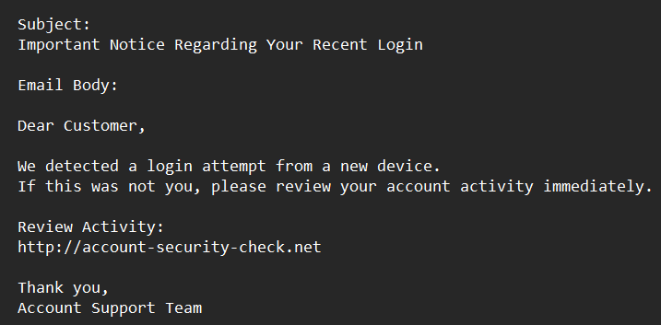
SAMPLE EMAIL 2
Subject:
Important Notice Regarding Your Recent Login
Key Indicators:
• Generic greeting
• Suspicious link
• Fear-based wording
• Unverified domain
Risk Classification:
SUSPICIOUS EMAIL

Slide 7
ANALYSIS OF SAMPLE 2
Identified Indicators:
• Suspicious login verification request
• Misleading domain
• Social engineering attempt
Business Impact:
Users may be redirected to fake websites designed to harvest credentials.
Overall Risk:
MEDIUM

Slide 8
RISK CLASSIFICATION SUMMARY
Indicator | Risk Level
Suspicious Links | High
Fake Domains | High
Urgency Tactics | Medium
Generic Greetings | Medium
Social Engineering | Medium

Slide 9
PREVENTION GUIDELINES
• Verify sender addresses carefully
• Avoid clicking suspicious links
• Never share passwords or OTPs
• Use Multi-Factor Authentication (MFA)
• Report suspicious emails immediately
• Confirm urgent requests through official channels

Slide 10
DO'S AND DON'TS
DO:
• Verify email authenticity
• Check links before opening
• Use strong passwords
• Keep systems updated
DON'T:
• Click unknown links
• Download suspicious attachments
• Share credentials via email
• Trust urgent threats immediately

Slide 11
CONCLUSION
This phishing detection and awareness assessment identified multiple phishing indicators, including suspicious domains, urgency tactics, misleading links, and social engineering methods.
The report highlights the importance of cybersecurity awareness and cautious email handling in reducing phishing-related risks.
The analysis was conducted ethically for educational and awareness purposes only.

Slide 12
THANK YOU
Future Interns — Cyber Security Internship
Prepared By:
Sidhanth Achar

